Slide 1

Airbnb Price Optimization Strategy
Maximizing Revenue Through Data-Driven Pricing
Team G-18 | Travel SectorPratiti Paul · Jatin Kumar Singh · Chirag Lalwani · Priyansh Satija · Shane Joseph · Anuradha Raghwanshi

Slide 2
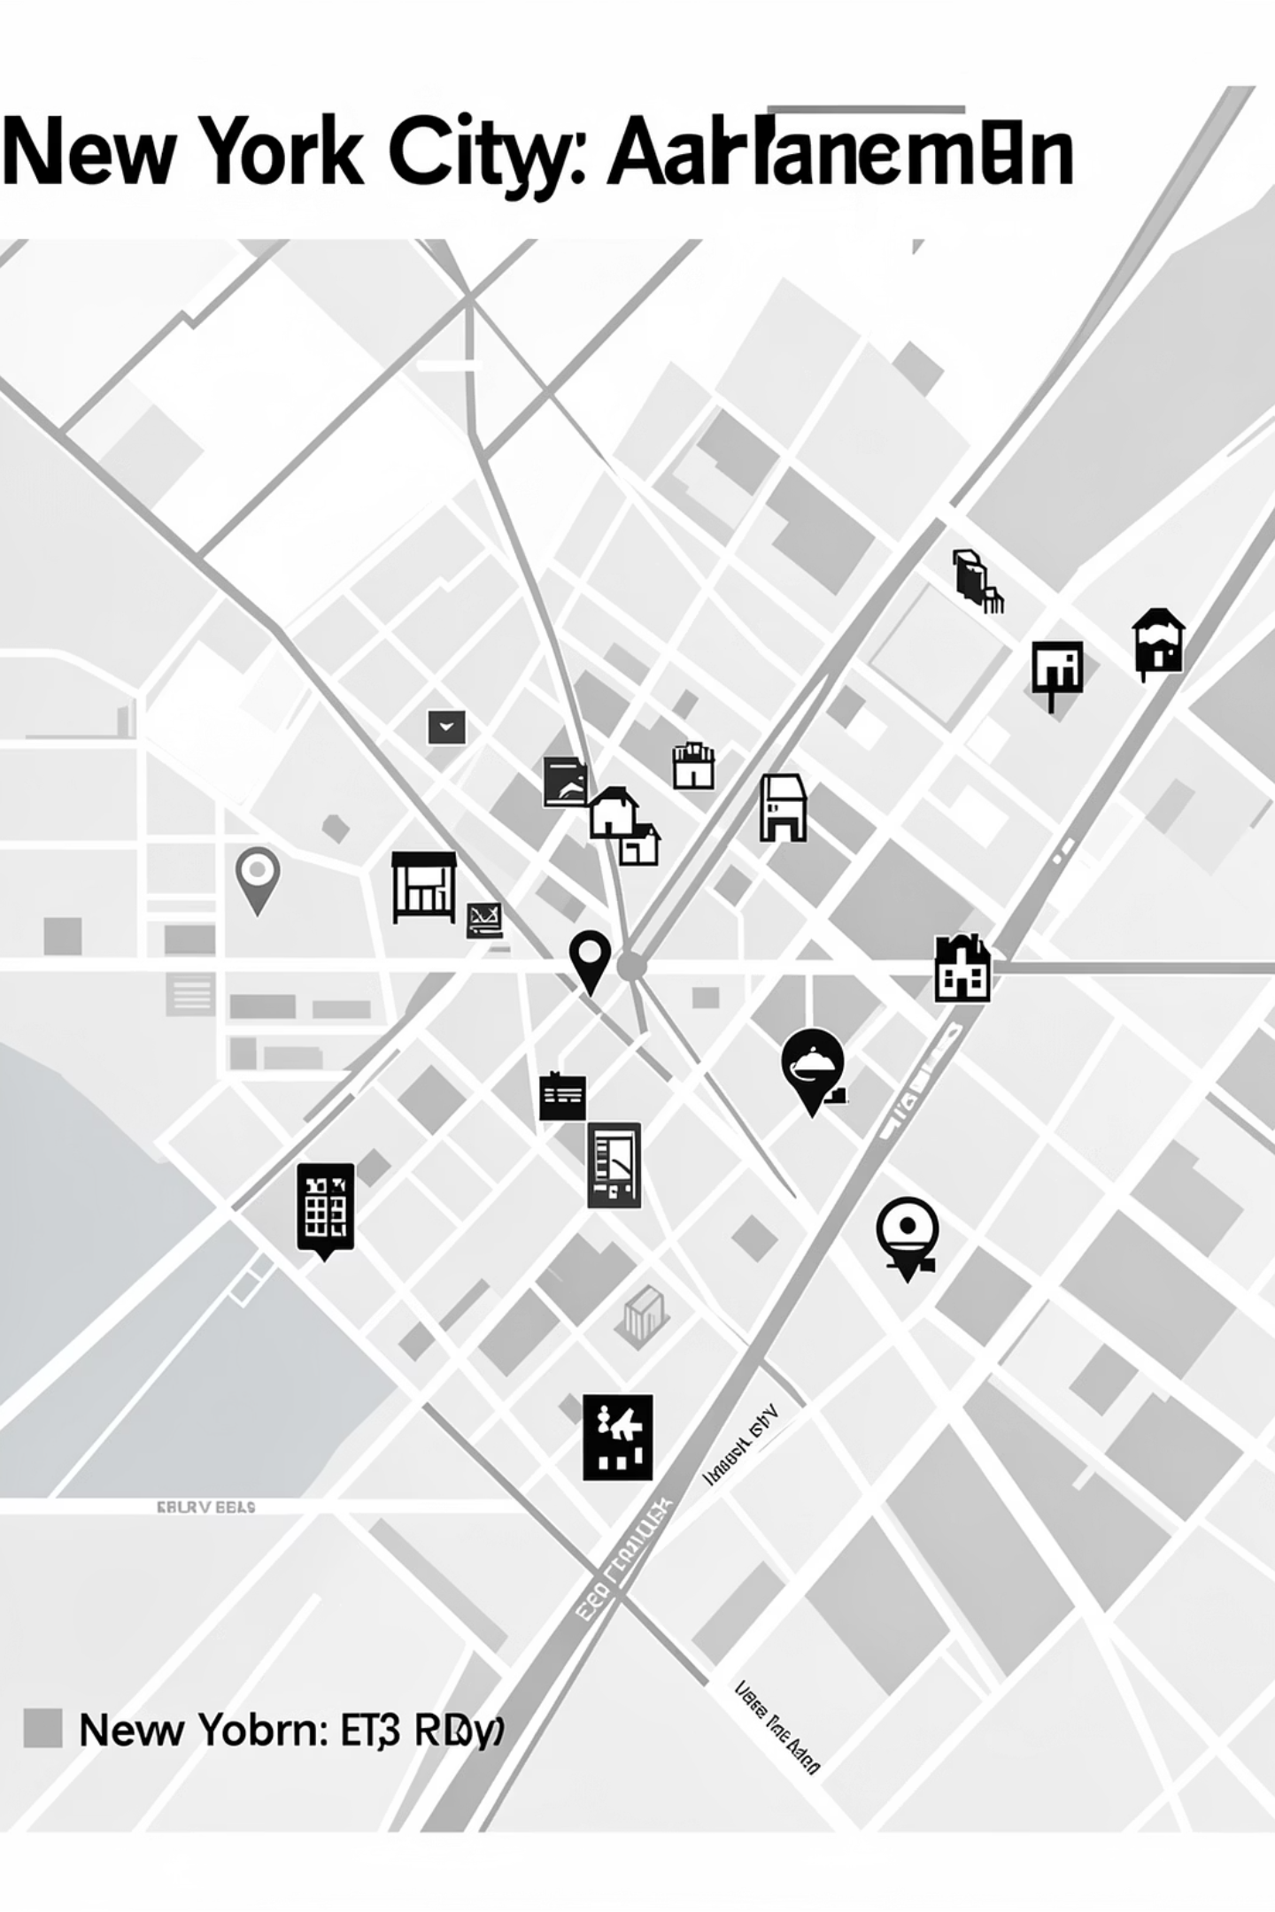

The Pricing Challenge in NYC
48,000+ Listings
Overpricing Risk
High price variability across NYC's competitive market (2019)
Reduces occupancy and booking efficiency
Underpricing Risk
Leaves revenue on the table
Key Business Question: What is the optimal pricing band by location and room type to maximize revenue without losing demand?

Slide 3






From Raw Data to Actionable Insights
Raw Data
Cleaning
Analysis
Dashboard
Recommendations
Source
Cleaning
Key Variables
NYC Airbnb Open Dataset · 48K listings · 16 attributes · 2019 snapshot
Handle missing reviews, remove price outliers, convert to numeric, standardize dates
Price · Availability_365 · Room Type · Reviews · Neighbourhood Group

Slide 4




Revenue Optimization Measurement Framework
Estimated Revenue
Occupancy Rate
Price × Occupied Days
365 − Availability_365
Average Price
Reviews per Month
Mean nightly rate
Trust & market traction
Why these KPIs? Revenue = Profitability · Occupancy = Demand · Reviews = Market Trust · Price = Strategy Lever

Slide 5
What Drives Airbnb Revenue in NYC?
1
Private Rooms show strongest revenue stability
2
Manhattan supports premium pricing but xfaces saturation
Consistent occupancy at fair price points drives predictable revenue
High willingness to pay meets tighter demand elasticity
3
Mid-price bands achieve best revenue-demand balance
4
Extreme high pricing reduces booking efficiency
Optimal trade-off between nightly rate and occupancy rate
Sharp drop in occupied days above 95th percentile pricing threshold

Slide 6
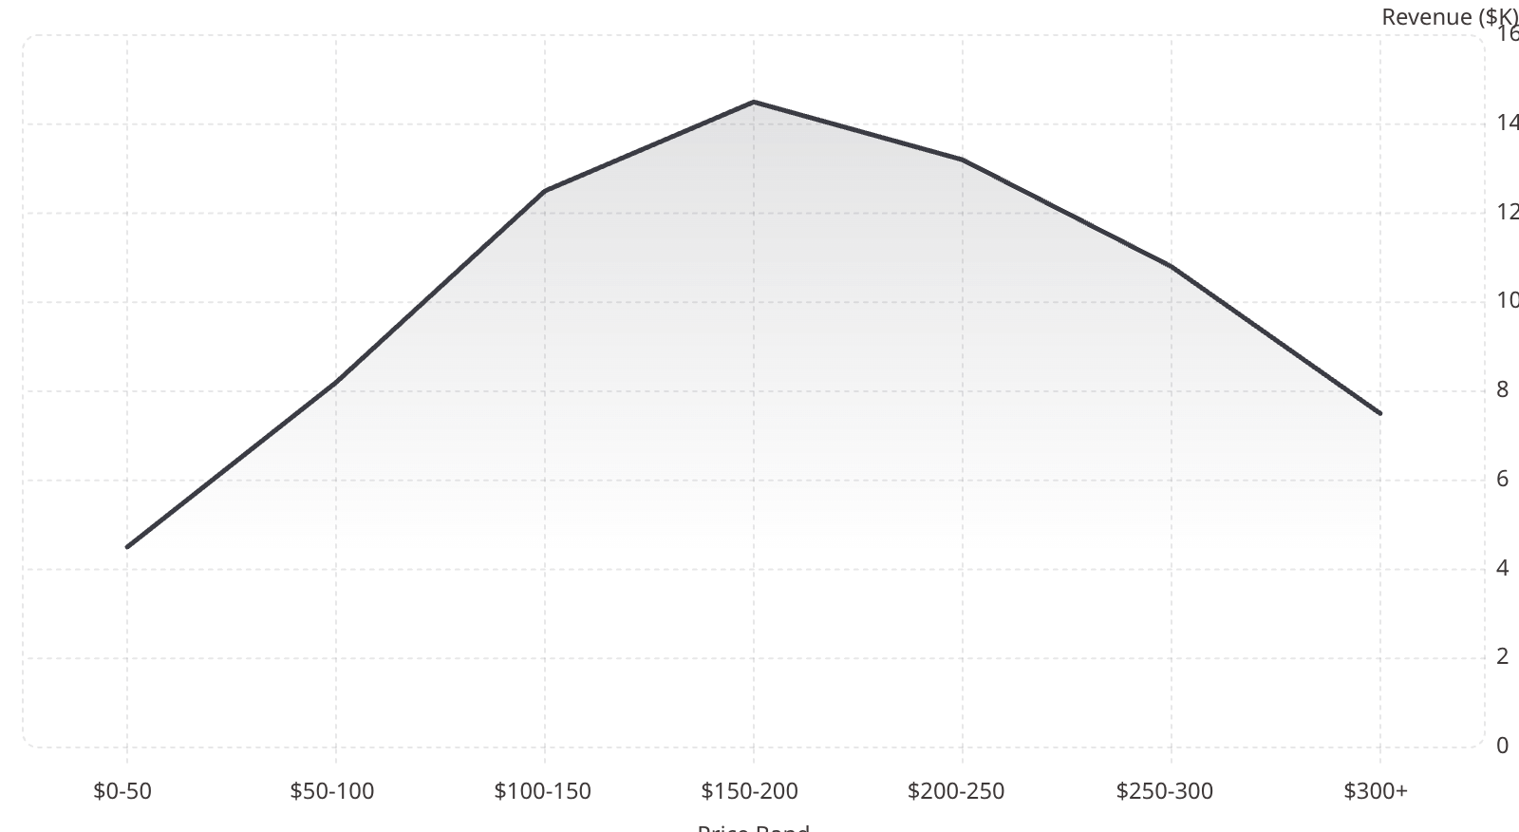

Identifying the Optimal Pricing Zone
Price × Demand Segmentation
Revenue vs Price Band
Budget High-Occupancy
Premium High-Demand
Underperforming
Competitive Mid-Tier (TARGET)
Strategic Insight: Revenue maximization occurs in the mid-to-upper pricing band ($100–$200) where occupancy elasticity remains favorable.

Slide 7
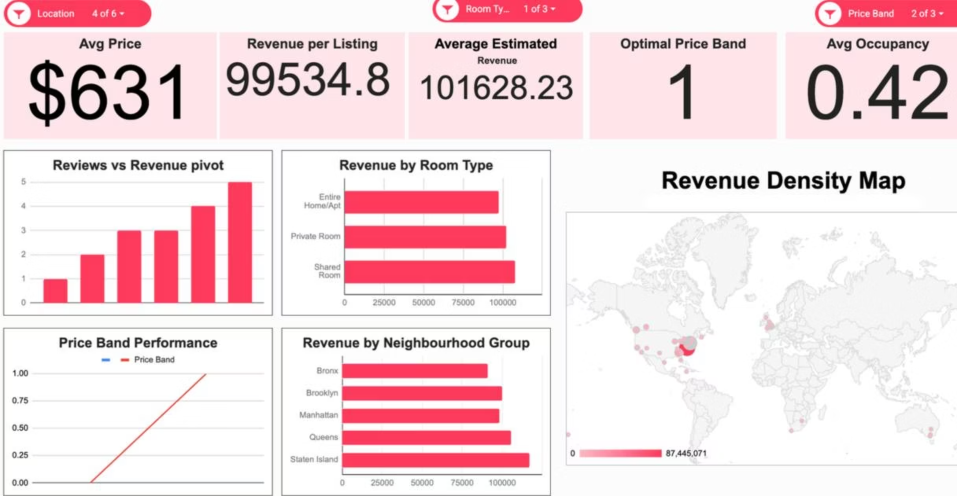
Interactive Pricing Intelligence Dashboard
Executive View
Operational View
Filters
Avg Revenue · Avg Occupancy · Avg Price · Best Room Type
Revenue by Borough · Room Type · Price Band · Reviews vs Revenue
Location (Borough/Neighborhood) · Room Type · Price Band

Slide 8
Actionable Pricing Strategies
01
02
03
Borough-specific pricing
Price within optimal mid-to-upper band
Avoid pricing above 95th percentile
Capture willingness-to-pay differences across Manhattan, Brooklyn, Queens
Target the sweet spot where demand elasticity remains favorable
Prevent demand cliff and search rank penalties
04
05
Optimize minimum nights below 7
Accelerate early reviews
Expand booking pool and attract broader traveler segments
Discounts or premium amenities drive initial reviews and booking momentum

Slide 9
Projected Business Impact
5-15%
↓
↑
∞
Revenue Uplift
Vacancy Risk
Search Ranking
Scalable Framework
Per listing annual revenue increase through data-driven pricing
Steady occupancy through optimal pricing positioning
Improved competitive positioning and conversion rates
Repeatable methodology across all boroughs and property types

Slide 10
Limitations & Next Steps
Current Limitations
Future Enhancements
No seasonality data
Revenue is estimated proxy
Time-series forecasting
Dynamic pricing engine
Static 2019 snapshot lacks temporal patterns
Does not reflect actual net profit or booking confirmations
Predict demand patterns across seasons and events
Real-time algorithmic adjustments based on market conditions
Static historical dataset
Real-time dashboard deployment
No real-time market dynamics or trend evolution
Live monitoring and instant pricing recommendations for hosts

